Slide 1
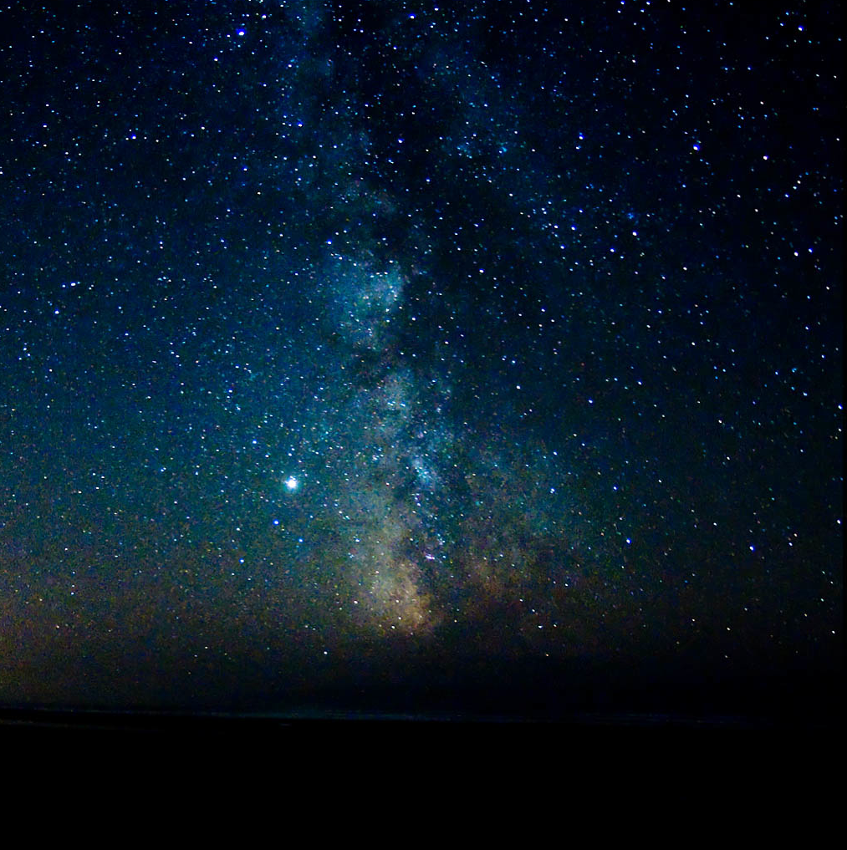
Better Lights for Better Nights!
Created by
Cindy Luongo Cassidy
Notes:
We all need light to see at night. You hear people say they want a “Dark Sky” ordinance. What does that mean to our lighting? What is the reality of so called “Dark Sky” practices?

Slide 2
Outdoor Lighting Challenges
Glare, Safety and Security
Light Trespass
Wasted Money & Energy
Community Economic Impact
Human & Environmental Impact
Notes:
Let’s first look at the challenges coming from our use of artificial outdoor lighting at night.

Slide 3
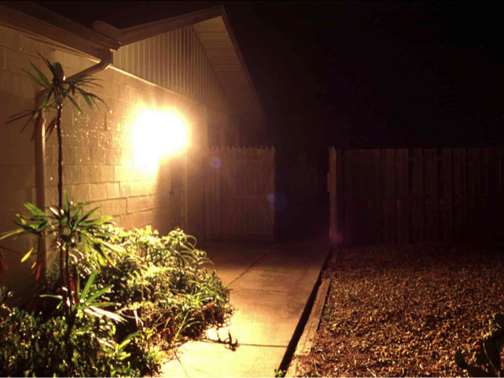
Does this Light Make You Feel Safe?
Notes:
Do you feel safe? Light makes us feel safe but are we really safe?
We can see there’s a bit of glare from this common flood light attached to the house. GLARE occurs when any bright, direct light hits your eye. If you can see the source of the light, it is producing glare.

Slide 4
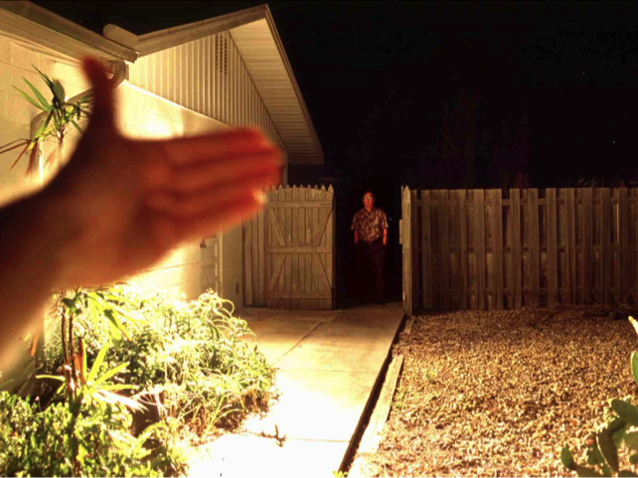
Glare creates dark shadows!
Notes:
What happens when we shield the source of the light? Wow – that gentleman was there all along! (Look back at the previous slide. If the room is dark enough, you can see the man in the previous slide too.)
Glare can severely diminish our ability to see well at night. Glare negatively effects both safety and security. Unshielded, over lighted or improperly aimed security lighting can actually reduce security by producing glare that can conceal someone with criminal intent.
The effects of glare can jeopardize everyone’s safety.
Why should we tolerate it?

Slide 5

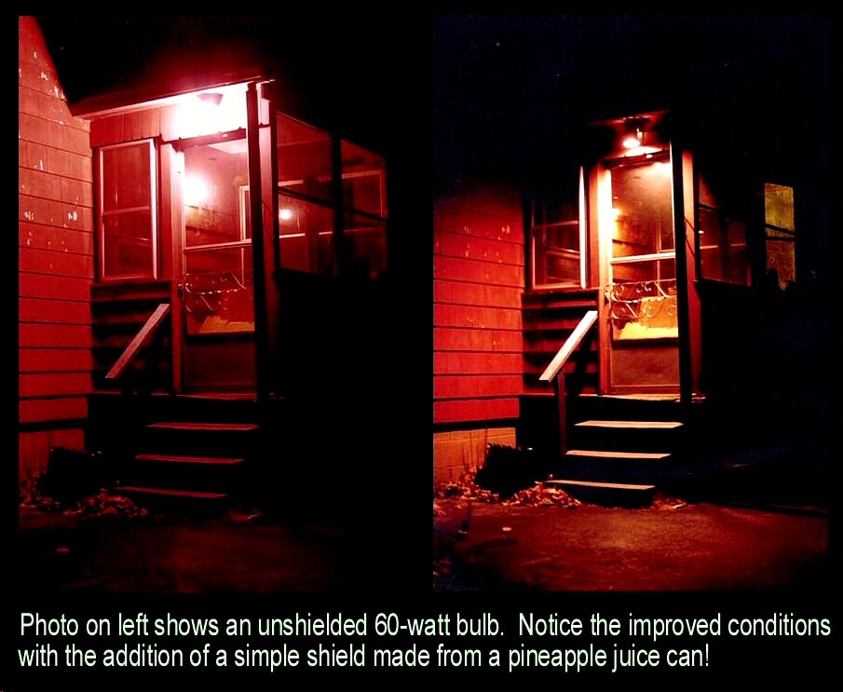
Entrance Safety
Photo Courtesy Southern Arizona Section IDA
Notes:
Most homes have some sort of outdoor light fixtures. Often there’s at least one near the front door or steps so you can see where you’re stepping as you come and go. Right?
Okay, let’s look at these two pictures. Notice the improved lighting on the steps and ground in the picture on the right. Also notice the glare in the picture on the left. What’s the difference in the light?
In the right-hand picture, the homeowner has taken a pineapple juice can, cut it to fit over the fixture, painted it to match the house and installed it over the bulb. Voila! This homemade shield protects the eye from the source of the light and points the light down where it’s needed. In doing so, the general visibility is improved and there is a great improvement in your ability to see where you’ll be walking.
Have you ever really looked at the lights around your house at night? Do they improve safety or blind you with glare? Do they waste your money by sending light where you don’t need it?

Slide 6
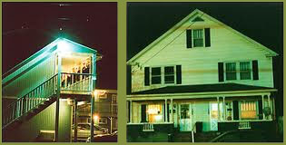
Light Trespass
Notes:
LIGHT TRESPASS occurs when stray light shines onto neighboring properties.
These buildings are across the street from each other. The home on the right has NO EXTERIOR LIGHTS ON! Can you imagine trying to sleep in this house?
Light trespass infringes on the property rights of the neighbor who has unwanted light intruding into his or her property. It can lower property values, reduce the quality of the nighttime environment and be a general irritant.
Everyone should have the right to the full enjoyment of property without being forced to live with unwanted light directed onto their property.
Shield and aim all lights on your own property so that you can’t see the source of the light from any other property and none of your lights shine above any structure or vegetation on your property.

Slide 7
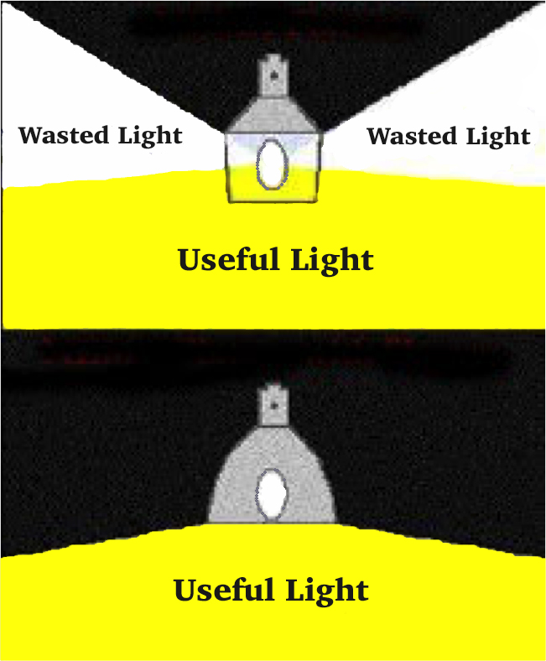
Shielding to Reduce Wattage!
Notes:
A shielded light will allow the owner to reduce the wattage approximately in HALF and get the same amount of useful light. HALF! That reduces the electrical cost in half. It cuts the amount of fuel needed to produce that energy in HALF. Plus it puts the light where it’s needed and reduces that GLARE that makes us less safe and secure. Are you seeing the win-win here? There’s more….. Notice that every challenge we‘ve talked about so far can be solved by shielding and directing lights onto the property where they originate rather than off or above the property.

Slide 8
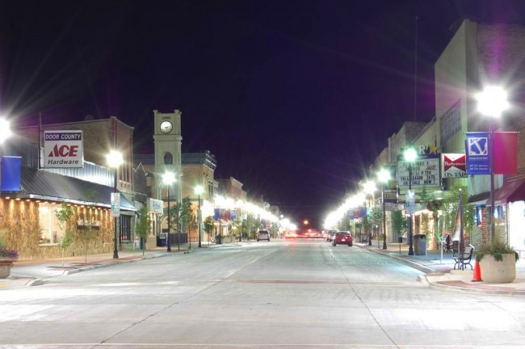
Will Light Clutter Attract Tourists?
Notes:
We need illumination to feel secure but we don’t need glare and we need much less light to see at night than has become customary. Too much light can detract from communities or individual properties.

Slide 9
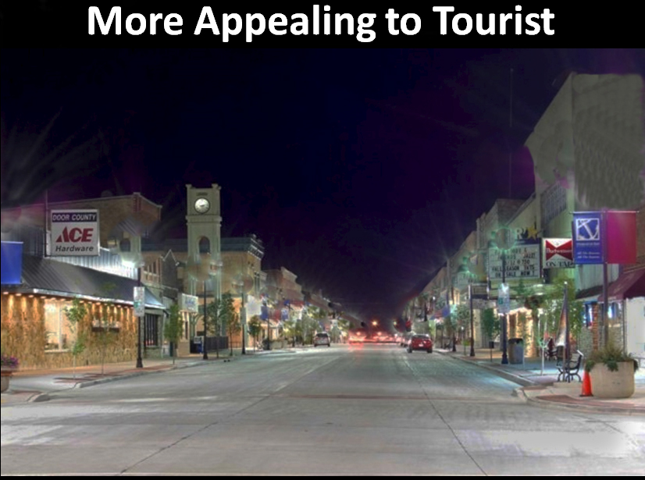
Notes:
We need illumination to feel secure but we don’t need glare. Too much light can be a detraction.

Slide 10
What about our view of the stars?
What about our Cultural Connection to the Stars?
Shared Stories
Science
Literature
Art
Notes:
Close your eyes and think about night when you were under a star filled sky. Take a deep breath and remember how it felt. You can open your eyes now but do you remember feeling more relaxed and grounded?
Think also about our cultural connection to the heavens. Humans have shared stories under and about the night sky for thousands of years. Our science, literature, and art are all influenced by stars and our view of the universe.
Other living things are dependent on the natural night sky too and are affected by the diminishing of the night sky by artificial light.

Slide 11
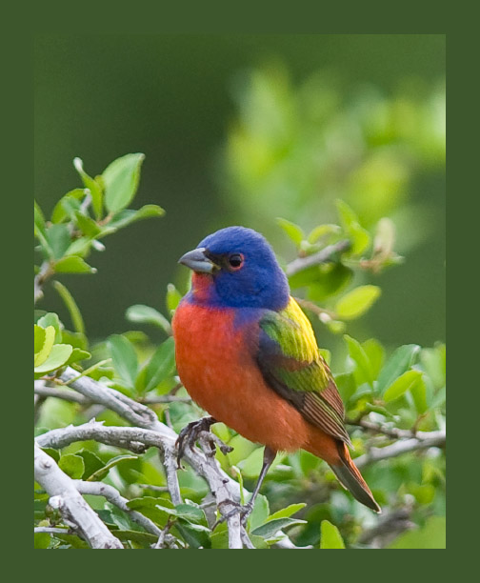
Life on Earth Depends on
Natural Darkness!
Photo courtesy
Susan RIley
Notes:
Almost all living things – plants and animals – need natural darkness to thrive. Our artificial lights disrupt the navigational systems of many animals, including our beautiful migratory birds. Our artificial lights at night cause the disruption of reproductive processes, circadian rhythms, and annual cycles. Part of that is the suppression of melatonin in almost every living thing. Melatonin is exceptionally important for health! Artificial light alters when plants bloom. It changes the balance between predators and prey. Our artificial light slipping into the world beyond where we need to see causes habitat destruction. What can we do about that and about the other challenges of outdoor lighting we’ve talked about?

Slide 12
How do we deal with these challenges?
Notes:
How do we change our outdoor lighting to see better and fix these problems? We’ve talked about the results of poor lighting. What does good quality lighting look like?

Slide 13
Protecting Ourselves &
The Night Sky
Start with a Good Shielded Fixture
Aim Lights Down
Use Only the Amount Needed
Pay Attention to the Light Color
Turn it Off
Notes:
Following these guidelines, we can have as much light as we need while we limit the harmful effects and waste that can be associated with outdoor lighting!
Let’s look at some examples…………

Slide 14





Use the 5 Principles for Responsible Lighting
Notes:
So how to we address the “challenges” of light pollution? 1) All light should have a clear purpose 2) Light Should be directed only to where needed 3) Light should be no brighter than necessary 4) light should be used only where it is useful 5) use warmer color lights where possible

Slide 15
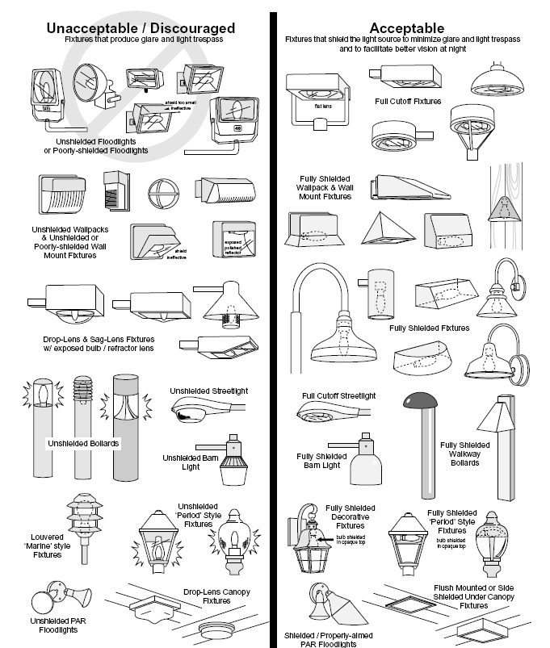
Drawings by
Bob Crelin
Notes:
Offer “Better Lights for Better Nights” handout prepared by Bob Crelin.
Note that all the lights on the “Acceptable” side shield the source of the light. This is one of the keys to being able to see better. Shield that light source!

Slide 16
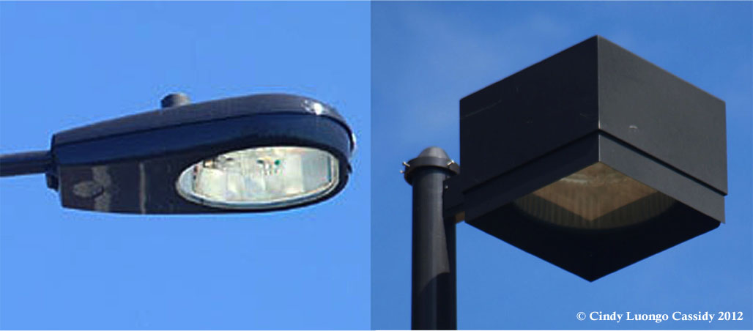
Full Cutoff &
Fully Shielding the Light Source
Notes:
Additional shielding protects us from glare and light trespass. The one on the right is the best! Note that the term “Fully Shielded”, as defined by the lighting industry, does NOT include the shield that you see in the photo on the right. Either recessing or shielding the source of the light so that you do not see the source from any other property (nor from above) reduces the light that shines in the “glare zone” and makes it easier for us to see at night.

Slide 17
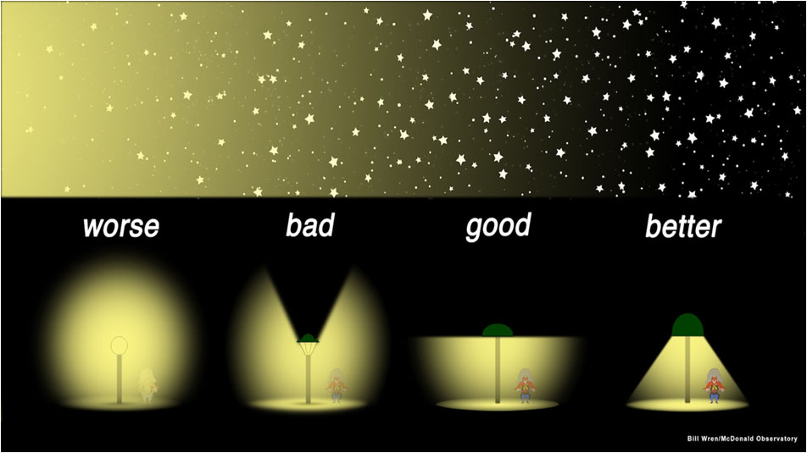
Aim Lights Down
Notes:
We can have the outdoor lighting we need and protect the night sky at the same time. Shield lights in the same way as the one on the far right. Notice the circle of useful light is the same in each depiction.
NOTE: For many years we thought that “full cutoff” lighting – like the one labeled “good” was the right thing to do. We now know that the light within 15 degrees up and down from that 90 degree “full cutoff” creates more sky glow than light that is directed straight up into the sky. So, go for the recessed light like the one labeled “better”.

Slide 18
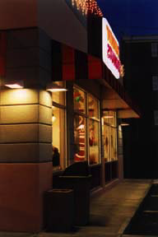
Use Only the Amount Needed
Notes:
Shielded lighting provides a safer and more attractive solution.
Shielded / recessed lights are a great solution for residential or commercial needs. The key is to install the fixture or shield so that the light neither spills above the horizontal nor onto neighboring property.
Recessed or fully shielded lights under the gas station canopy provide excellent illumination to the pumps and the general area without creating glare for drivers pulling in or driving by.

Slide 19
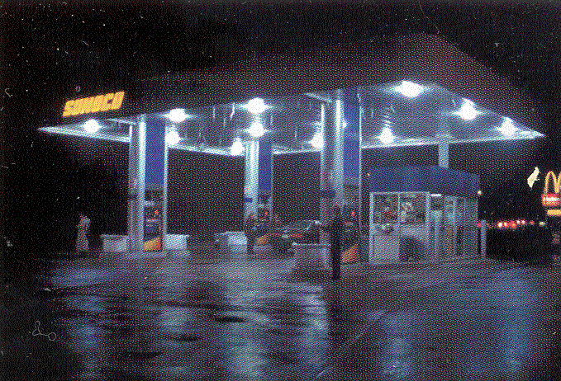
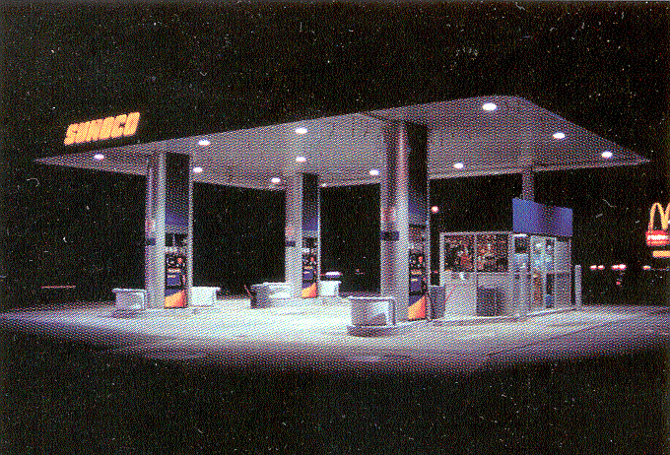
Good lighting can improve business!
Glare is not comfortable for your eyes. This service station had an immediate increase in business after installing shielded lights.
Copyright 2002 Rensselaer Polytechnic Institute; courtesy Lighting Research Center
Notes:
Keep in mind that in addition to seeing better, saving money, protecting our health, and protecting the night sky, that good lighting is an asset for a business.
A lot of businesses seem to be raging a war to see who can have the brightest lights. As you pull out of a brightly lit business into the darker street or vice versa, it takes your eyes time to adjust. During that adjustment period you and any other cars or people around you are at risk.
Not too long ago this service station shielded it lights and reduced the wattage as a test. Notice in the picture on the right that the shielded lights, which are directed towards the ground, produce a more even distribution of light where it is needed, allowing you to see more clearly in the lit area as well as on the edges of the lit area.
The unshielded lights on the left not only produce glare that reduces your ability to see but, the lights are so bright that the beams of light hit the ground and bounce back producing additional glare. Notice how the service station details look fuzzy in the photo on the left. That’s a result of all the glare.
They shielded their lights as part of a LP reduction experiment. They were surprised when they got an immediate increase in business.

Slide 20
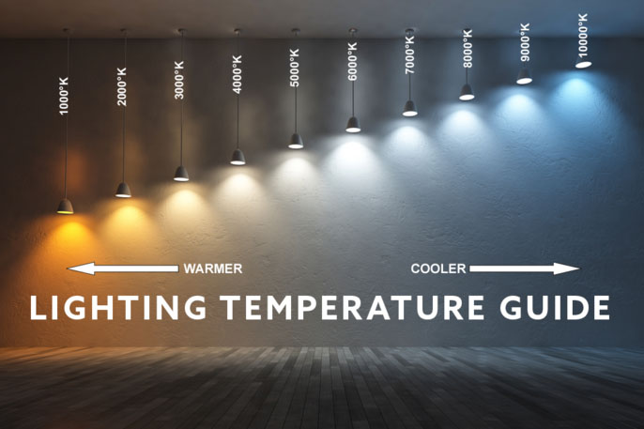
Notes:
Cooler lights (specifically cooler, whiter LED’s) create more glare and therefore reduce our ability to see at night.
Warmer lights not only create less glare but they have less light in the blue wavelength. It’s that blue wavelength of lights that is most efficient at stopping our melatonin production. That is, the cooler, whiter lights are more detrimental to your health than the warmer lights.
If Needed: The cones of the retina respond to bright, whiter lights and provide daytime, that is, photopic, (fo’ topik) vision. The rods are sensitive to dim light and we use them for nighttime, that is, scotopic (sca’ ta pik), vision. Cones respond best to light in the yellow spectrum and rods are most sensitive to light in the blue-green spectrum. So, we not only need less wattage to see best at night but we need to consider the color of the light.

Slide 21
Turn the Lights Off
When You’re Not There to Use Them
Notes:
Turn your lights off when you’re not there, or anytime you can take the time to let your eyes adjust to see by the stars and moon.
Yes, lights can make us feel more secure – but not necessarily BE more secure. We need to make sure the lights don’t create glare that can blind us and that they don’t create a sharp contrast between the lit and unlit areas.
We should remember that criminals need light too. Lighting manufacturers will tell you that lights prevent crime. But professional studies in the U.S and abroad show that light does not deter crime.
To use lights to improve security, the most effective means is to provide a sudden change to the surrounding environment. Sensor governed security lighting that turns on when someone approaches an area is the most effective means of attracting attention and driving away someone with criminal intent. Remember that even these lights should be installed so that they neither produce glare nor uneven illumination that can conceal a criminal.

Slide 22
Yes, You Can Choose
Better Lights for
Better Nights!
I challenge you to modify your lighting practices to see better, save money & protect the night.
Notes:
The Challenge

Slide 23
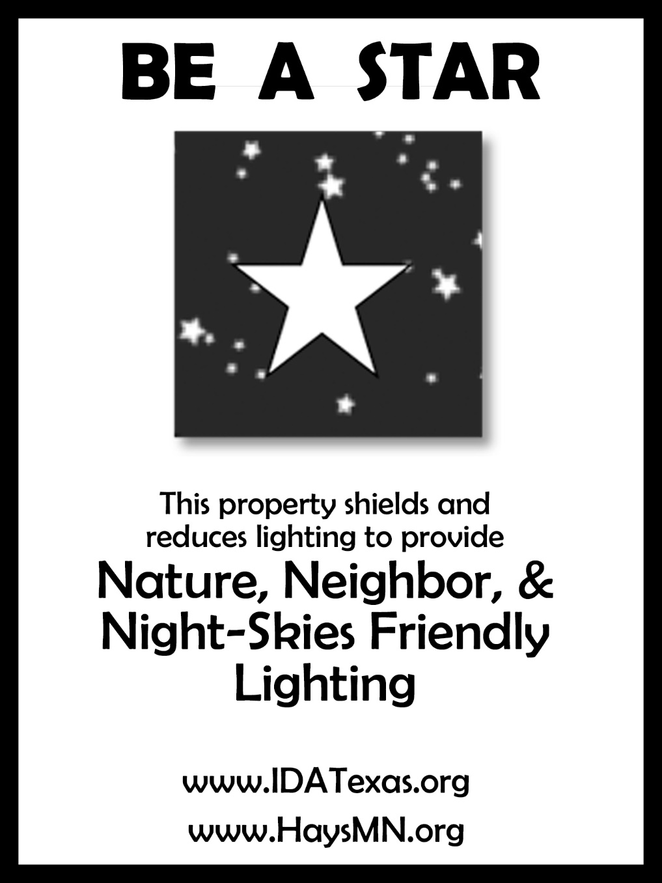
Participate in the
Be A Star Award Program
Notes:
Back to Cindy’s Theme and The Challenge

Slide 24
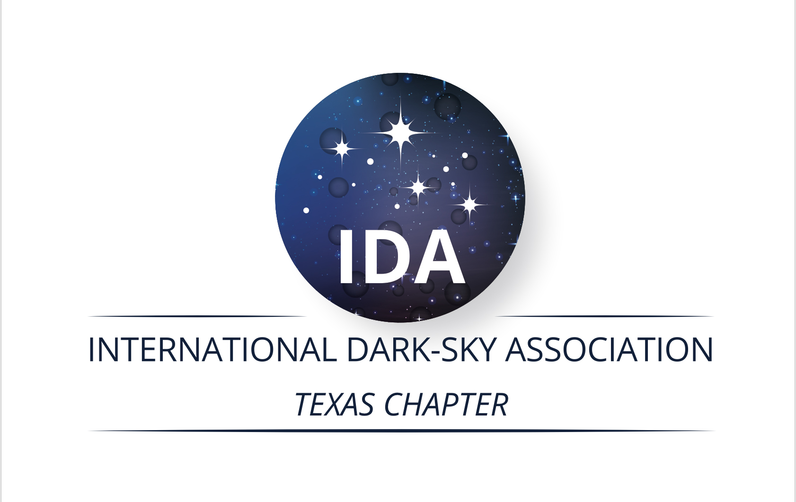
Resources
www.IDATexas.org
www.Darksky.org
www.GlobeatNight.org
http://www.need-less.org.uk
Notes:
Back to Cindy’s Theme and The Challenge

